Slide 1



Search And Rescue Optimal Planning System
SAROPS
Thomas M. Kratzke and Lawrence D. Stone, Metron Inc
John R. Frost, U. S. Coast Guard
July 28, 2010

Slide 2
History and Background
US Coast Guard established the Air Sea Rescue Agency in 1944
  Result of air-sea rescue operations during the WWII
  Used “Methods of Locating Survivors at Sea on Rubber Rafts” US Navy Hydrographic office, 1944 for planning searches
    Influenced by Koopman’s work in ASWORG later reported in “Search and Screening” 1946.
  In peace time this became Search And Rescue (SAR)
    USCG published first Search and Rescue Manual in 1959 based on Koopman’s 1956 -7 articles on search theory in Operations Research
    Manual method given in this publication remained basic technique until 1967 – minimax technique added to account for uncertainties in leeway
  SARP – Search And Rescue Planning program - 1970
    Computer version of manual methods with some additions
Computer-Assisted Search Planning, CASP developed in early ’70’s.
  Deployed in 1974 on a CDC 3300 in Washington, DC
  Monte-Carlo simulation (early particle filter)
    Search Planning aid was primarily a display of cellular distributions.
  In use until March 2007!

Slide 3
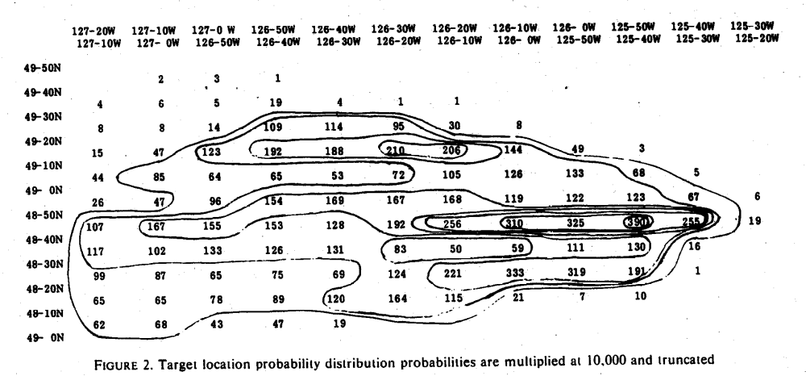
History and Background
Early CASP Probability Map

Slide 4
History and Background
Search and Rescue Optimal Planning System (SAROPS) development began in October 2003. Designed to take advantage of better
  Environment Data information – winds, currents, visibility, cloud cover
  Models for
    Drift and leeway of search objects
    Search sensors
  Theoretical developments in search planning
    Search for moving objects, multiple search object types, survivor search
  Computer computational power and geographic displays
SAROPS became operational in March 2007.
  Developed by Northrop Grumman, Metron, and Applied Science Associates (ASA)

Slide 5
Early SAROPS Success
Cruise Ship Passenger Goes Overboard; Is Rescued 8 Hours Later
  By Robert Nolin and Ihosvani Rodriguez; South Florida Sun-Sentinel March 17, 2007
Michael Mankamyer was 30 miles off Fort Lauderdale treading water in choppy seas.
  Eight hours earlier, the 35-year-old Orlando man had jumped from a cruise ship balcony
  Rescue officials were at a loss to say why, though a witness said he was drunk.
Salvation came at 8:45 a.m., when a lookout on the Coast Guard cutter Chandeleur, Petty Officer Ryan Coon, saw Mankamyer in the fresh sunrise about 75 yards away.
He was shirtless, splashing and thrashing his arms. I knew that was our guy," Coon told reporters Friday evening.
  "I hollered out, `Man overboard, portside!'“ The crew threw Mankamyer a life ring; he swam up and grabbed it.
Nancy Nelsen, a civilian search and rescue specialist in the Coast Guard's Miami office
  Credited a new computer model, the Search and Rescue Optimal Planning System, or SAROPS, for helping locate Mankamyer.
  The system analyzes wind and currents and uses an animated grid model to project where a floating person could be.

Slide 6
SAROPS Methodology - Bayesian
Assemble data, information, assumptions
Produce scenarios
  Group information into logical “stories”
    Each story equals a scenario; Scenarios can be inconsistent – capture dissonant information
  Quantify uncertainties using probabilities
  Produce a probability distribution for object location from each scenario
Produce prior object location distribution
  Weight scenarios (subjective) and compute prior as weighted sum of scenario distributions
Plan search effort
Assess unsuccessful search
  Record search effort
  Estimate detection capabilities of sensors
Update prior location distribution to account for unsuccessful search
  Compute posterior distribution for target location given unsuccessful search
Use posterior to plan next phase of search
Using the posterior as the prior, repeat last three steps until done

Slide 7
Basic Components of SAROPS
Environmental Data Server (EDS) developed by ASA
  Gathers and provides environmental products for SAROPS
Simulation (SIM) developed by Metron
  Produces and updates probability distributions for location of search object
Planner developed by Metron
  Recommends search patterns for ships and aircraft to maximize detection probability (probability of success).
Graphical User Interface (GUI) developed by Northrop Grumman
  Uses a ArcGIS as base for GUI

Slide 8
(CMF)
CJMTK Mapping Framework
(ArcGIS 9.2)
COP
EXT
WWW
TMS
GEBASE
EDS
Maptech
MORE
EXT’S
3D Analyst
SAROPS Extension
GUI
SIM, Planner
SAR Tools Extension
Flares, Patterns, Etc
Spatial - A
GeoStat - A
WeatherFlow
SAROPS
C-Map
Other…
Notes:
Block diagram of SAROPS to ArcGIS and other software.
SAROPS is an “extension” of ArcGIS

Slide 9
Goal: Assist in Planning Searches for People Missing at Sea
Three Parts to the Problem
  Gather the information from the user on what is known.
    GUI and EDS
  Compute a probability distribution for the location of the missing person.
    Simulator
  Given a distribution and Search and Rescue Units (SRUs), recommend deployment of SRUs to maximize our chance of finding the missing person?
    Planner
Focus of this talk is the Simulator and Planner

Slide 10
Simulator
  Monte-Carlo simulator produces distribution
  Pre-distress is described with scenarios.
    Examples: Sequence of waypoints, Dead-Reckoning, Last-Known Position. SAROPS has these and other scenario-types.
    Scenarios carry weights.
    Each Scenario has its own collection of particles.
  Transition to distress
    “Uniform” draw for when the distress occurred
      Influenced by hazards
    Draw for the type of post-distress object
  Post-distress motion
    Moves according to the winds and currents
    They affect different object types differently

Slide 11
Example of Scenario
Fishing Area 1
Probable Error of Turn Point Position
Home Port
Fishing
Area 2

Slide 12
Example of Scenarios and Object Types
  One Scenario (Pre-Distress Motion)
    Mayday call; tight circular distribution for position of distress and time of distress.
  Two Object Types (Post-Distress Motion)
    He got into a raft (P=0.4) or he is in the water (P=0.6)
      Former case; his position is more influenced by the winds, and he is easier to find.
      Latter case: his position is more influenced by the currents, and he is harder to find.
  Post-Distress Motion
    Uses environmental data and random fluctuations
    Fluctuations are correlated for a single particle

Slide 13
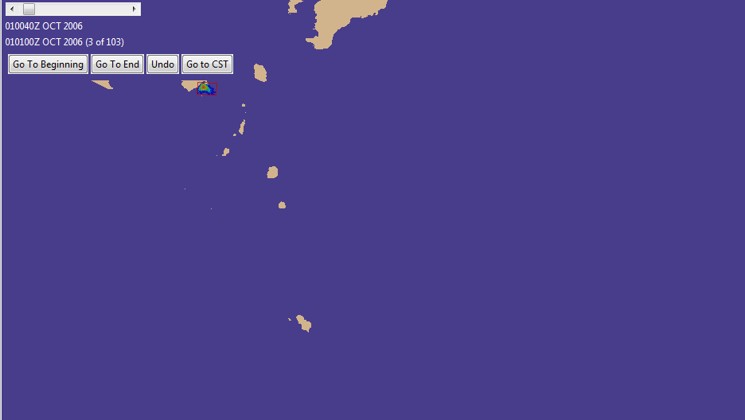
Example: Prior
  Last Known Position Scenario
  Distribution as of Distress Time
  (Just below the “Go to CST” Button)

Slide 14
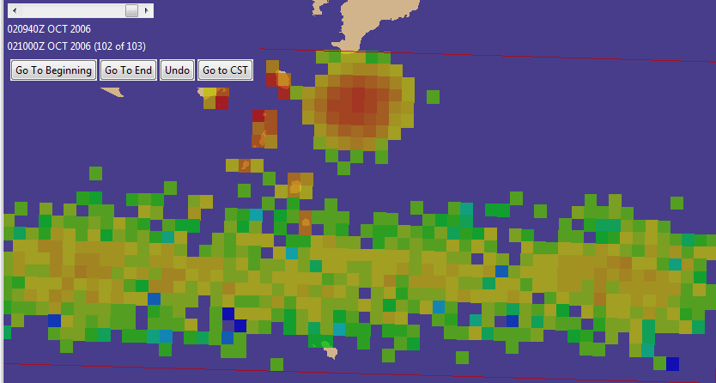
Example of Distribution from Drift
  Winds are from the north and “sent the rafts” into the southern band, with the two modes from gibing. Winds had little effect on “the PIWs.”
  Currents are to the east and the northern mode is PIW

Slide 15

Updating for Unsuccessful Search
Search takes place from aircraft or ships.
  Search paths are in form of straight line segments
  Sensors are typically visual but can be radar.
  Sensors are characterized by a lateral range function λ which gives probability of detection as a function of r distance at point of closest approach on a line search segment
Probability distribution for object location is given in terms of a set (say 4,000) of particles. Each particle specifies a possible path for the object as well as its type.
Suppose that a Search and Rescue Unit (SRU) has performed an unsuccessful search which consists of K straight legs.
  Let d_{k} be the distance a the point of closest approach of the k th leg to a particle p during the time of the leg . SIM computes
  the probability that the SRU fails to detect p during its search
sensor path
r
search object

Slide 16

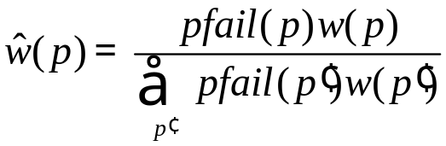
Updating for Unsuccessful Search
SIM computes to obtain the probability that search by all SRUs fails to detect p.
Let w(p) be probability on particle p. Then the posterior probability is
This process of updating for unsuccessful search is followed for each search.
Posterior distributions are displayed by choosing a display time, gridding the ocean into cells, and computing the sum of the posterior probabilities of the particles in each cell at that time.
  The distribution is usually displayed in color coded fashion with high probability cells shown in red and low in blue.

Slide 17
Planner
A set of SRUs is specified for the search
  Each SRU has different detection characteristics for each of the object types
    These are characterized by lateral range curves as discussed above
      Depend on sensor, target type, and environment
  Each SRU has a time on scene, endurance, speed
Planner assigns a rectangle to each SRU
  A rectangle induces a parallel path search.
Goal of Planner is to maximize Probability of Success (POS) by placing the rectangles intelligently
POS is computed as follows
  Let w(p) be the (posterior) probability on particle p. Then

Slide 18
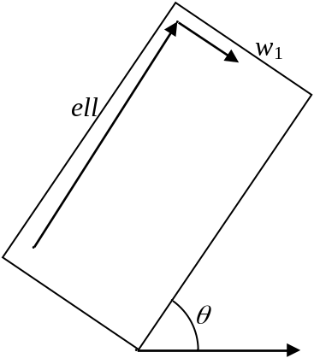
Planner
  A Rectangle is defined by 5 variables:
    Center (2), Orientation (1), Length (ell) and Width (w) (2)
  Each SRU has a path-length (L)
  The set of allowable rectangles is constrained as follows
    The track spacing s, leg length t, and path length L must satisfy
    Rectangles can not overlap
  An allowable rectangle specifies (almost) a path
  From the path (set of legs) we can compute

Slide 19
Mathematical Formulation
  Constrained Optimization problem with 5n variables, where n is the number of SRUs.
  Use iterative techniques for “solving” the problem
  Need initial solution
  Need algorithm for iterating. Three Steps:
    Iterate to a feasible solution (decrease overlap to zero).
    Iterate to a local maximum (increase POS).
    “Jump” an SRU to look for a different local maximum.

Slide 20
Computational Strategy(1)
  POS can be approximated 3 ways:
    1. POS-A (Fastest but least accurate): Uses POC * POD, where:
      POC is “probability of containment;” the proportion of particles that are in the rectangle
      POD is “probability of detection;” the probability of detecting a particle given that is known to be in the rectangle
      In general, POC goes up for bigger rectangles, and POD goes down.
    2. POS-B (Slower than POS-A but a good approximation to POS-C (below))
      Computes POS particle-by-particle for every leg of every SRU, but downsamples the particles.
    3. POS-C (Exact: Used to report the results)
      Computes POS particle-by-particle for every leg of every SRU, and for every particle.

Slide 21
Computational Strategy(2)
  Use POS-A while looking for a feasible solution
    Decrease the overlap of the rectangles while keeping POS-A as high as possible.
  When no overlap, use POS-B
  Technically, we are supposed to maximize POS-C, but we maximize POS-B, and then compute and report POS­C.

Slide 22
Basic Algorithm: Initial Placement
  Greedily place the first SRU:
    Align with the mean drift
    Look for a rectangular array of cells by starting with the best cell and adding/subtracting rows and columns until we can’t improve the POS, using method “A” to approximate POS.
  Update the probabilities of the particles.
  Place the second SRU.
    Allow overlap, but only some overlap.
      Goal is to leave us with a “fixable” amount of overlap during the second part of the algorithm
  Place third and remaining SRUs similarly.
  At each step, maintain “admissibility”
    Admissible sets can have their overlaps cleared with small adjustments.

Slide 23
Basic Algorithm: Improve it
  “Poor man’s gradient method.”
    Used because of the discrete nature of the “length variable.”
    Also known as “refine” or “zero-in.”
  Each SRU has 14 possible “minor moves.”
    Examples:
      Move up ¼ nmi
      Expand to the right
      Contract to the left
  For each SRU, check each “minor move.”
    Make the move and check that move again if it:
      Increases POS, and doesn’t increase overlap, or
      Decreases overlap, and doesn’t decrease POS.
  When stuck at a local maximum, “Jump” one of the SRUs.

Slide 24
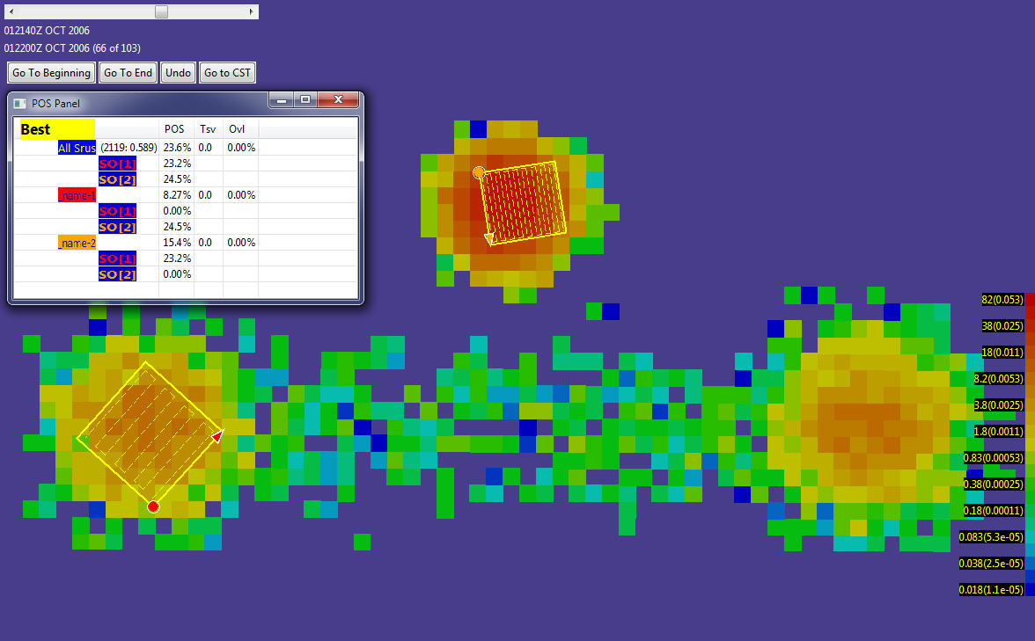
Picture of Planner Solution
One SRU went to the northern mode
The second focused on the left of the southern

Slide 25
Planner: Remaining Work
Better Initial Solutions
Better Choice of Minor Moves
  E.g, Some that are not the movement of a single SRU
Re-define what to Maximize
  Probability of finding Object AND Object is Alive
  Probability that Object is not expired
    No credit given for finding something that would be alive anyway
Use Optimization Libraries
  Use real gradient searches by introducing Path-Length as a sixth variable for each SRU, OR
  Solve problems for a fixed value of length, and combine results

Slide 26
Backup Slides

Slide 27
History and Background (3)
Team and Roles:
  Northrop Grumman is the prime
  Applied Science Associates: GUI and EDS
  Metron: Simulator and Planning Algorithms
More Information on the Web:
  http://www.military.com/news/article/coast-guard-news/cg-assists-in-search-for-air-france.html?col=1186032366581
  http://en.wikipedia.org/wiki/Search_and_Rescue_Optimal_Planning_System_(SAROPS)
  http://www.scientificamerican.com/article.cfm?id=people-lost-at-sea-found

Slide 28
Software Component:
GUI, EDS, SIM
SAROPS is the overall Program
Computational Engine (called SIM) is a Service
Workflow
  GUI collects information from user:
    Where, when, hypotheses on what happened
  Information on winds and currents are gathered from EDS
  Writes the information into an Xml file and environmental data files
    3 files; 1 model file (xml), 1 wind file (netcdf), and 1 currents file (netcdf)
  SAROPS sends SIM the 3 files and SIM creates a file of distributions (one for each 20-minute time period)
  SAROPS gathers more information about the search assets
  SAROPS asks SIM for a suggested search plan

